Slide 1
Paper presentation ETA Prediction with Graph Neural Networks in Google Maps Austin Derrow-Pinion1 , Jennifer She1 , David Wong2∗ , Oliver Lange3 , Todd Hester4∗ , Luis Perez5∗ , Marc Nunkesser3 , Seongjae Lee3 , Xueying Guo3 , Brett Wiltshire1 , Peter W. Battaglia1 , Vishal Gupta1 , Ang Li1 , Zhongwen Xu6∗ , Alvaro Sanchez-Gonzalez1 , Yujia Li1 and Petar Veličković1
Samiksha Karnaghatla
700754091

Slide 2

Motivation
Increasing number of vehicles and expanding road networks have led to significant traffic congestion.
Traffic congestion impacts daily commutes, causing delays and stress for millions of people.
Accurate ETA is crucial for personal travel, enabling better journey planning and timely arrivals.
In business, accurate ETA optimizes delivery routes, improves fleet management, and enhances customer satisfaction.
Public transportation relies on accurate ETA for efficient scheduling and minimizing delays.
Developing robust ETA models enhances both personal and commercial transportation systems, improving overall efficiency.

Slide 3

Problem Statement
This paper was presented at the 30th ACM International Conference on Information and Knowledge Management (CIKM ’21) held from November 1–5, 2021
ETA Definition: Estimated Time of Arrival (ETA) predicts travel time from a starting point to a destination.
Spatiotemporal Complexity: Capturing variations in traffic conditions across different times and locations is challenging.
Dynamic Traffic Conditions: Traffic changes rapidly due to accidents, weather, and sudden increases in volume.
Data Integration: Combining real-time traffic data, historical patterns, and external factors is complex.
Scalability: The model must handle numerous real-time queries, especially in large applications like Google Maps.
Solution: Our GNN model addresses these challenges with advanced techniques, providing accurate and robust ETA predictions.

Slide 4

Objectives
Develop a Robust GNN Model: Developing a Graph Neural Network (GNN) model specifically designed for accurate ETA prediction by leveraging the graph-structured nature of road networks.
Improve Prediction Accuracy: Enhancing the accuracy of ETA predictions by integrating real-time traffic data, historical patterns, and external factors into the model.
Ensure Stability and Robustness: Implement techniques such as Meta-Gradients and semi-supervised training to ensure the model remains stable and performs reliably under various conditions and regions.
Scalable Deployment: Design the model to handle large-scale, real-time deployment in applications like Google Maps, ensuring it can process a vast number of queries efficiently.
Quantitative and Qualitative Validation: Conduct comprehensive offline and online evaluations, including prescriptive studies and qualitative analyses, to demonstrate the model's effectiveness and provide insights into its performance in real-world scenarios.

Slide 5

Contributions
Major contributions:
Use of Graph Neural Networks (GNNs) for ETA prediction, leveraging their ability to handle graph-structured data effectively.
Innovations in featuring road network data to enhance model input quality and prediction accuracy.
Introduction of Meta-Gradients, a method for dynamically adjusting learning rates during training, resulting in more stable and efficient model training.
Semi-supervised training techniques to leverage both labeled and unlabeled data, improving model robustness.
Successful deployment of the GNN model in Google Maps, showcasing the model's readiness for production environments.
Achieved significant reduction in negative ETA outcomes, enhancing user experience and trust in the application.
Demonstrated scalability of the model, effectively handling a vast number of queries worldwide.
Studies and Analysis:
Conducted prescriptive studies on various architectural decisions, providing insights into the design choices that impact model performance.
Detailed qualitative analyses on real-world scenarios, highlighting situations where the GNN model outperforms traditional methods.
Performed offline ablations to understand the impact of different features and configurations on model performance.
Visualized specific traffic situations where the model's predictions offer a clear advantage, aiding in practical decision-making.

Slide 6

GNN (Graph Neural Networks)

Slide 7

GNN (Graph Neural Networks)
Graph Structure: GNNs operate on graph-structured data, where nodes represent entities (e.g., road segments) and edges represent relationships (e.g., connections between road segments).
Message Passing: In GNNs, nodes update their representations by aggregating information from their neighbors through a process called message passing.
This repetitive process allows each node to incorporate information from an expanding local neighborhood.
Layers and Iterations: GNNs consist of multiple layers, with each layer performing a round of message passing.
As the number of layers increases, the receptive field of each node grows, enabling the model to capture more complex insights from the graph.
Applications: GNNs are highly effective for tasks involving graph-structured data, such as social network analysis, molecular modeling, and traffic prediction in road networks.

Slide 8
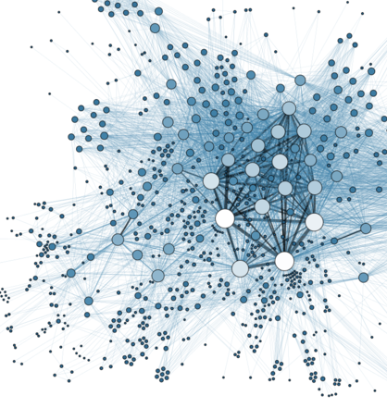
Graph structured data
ThePhoto by PhotoAuthor is licensed under CCYYSA.

Slide 9
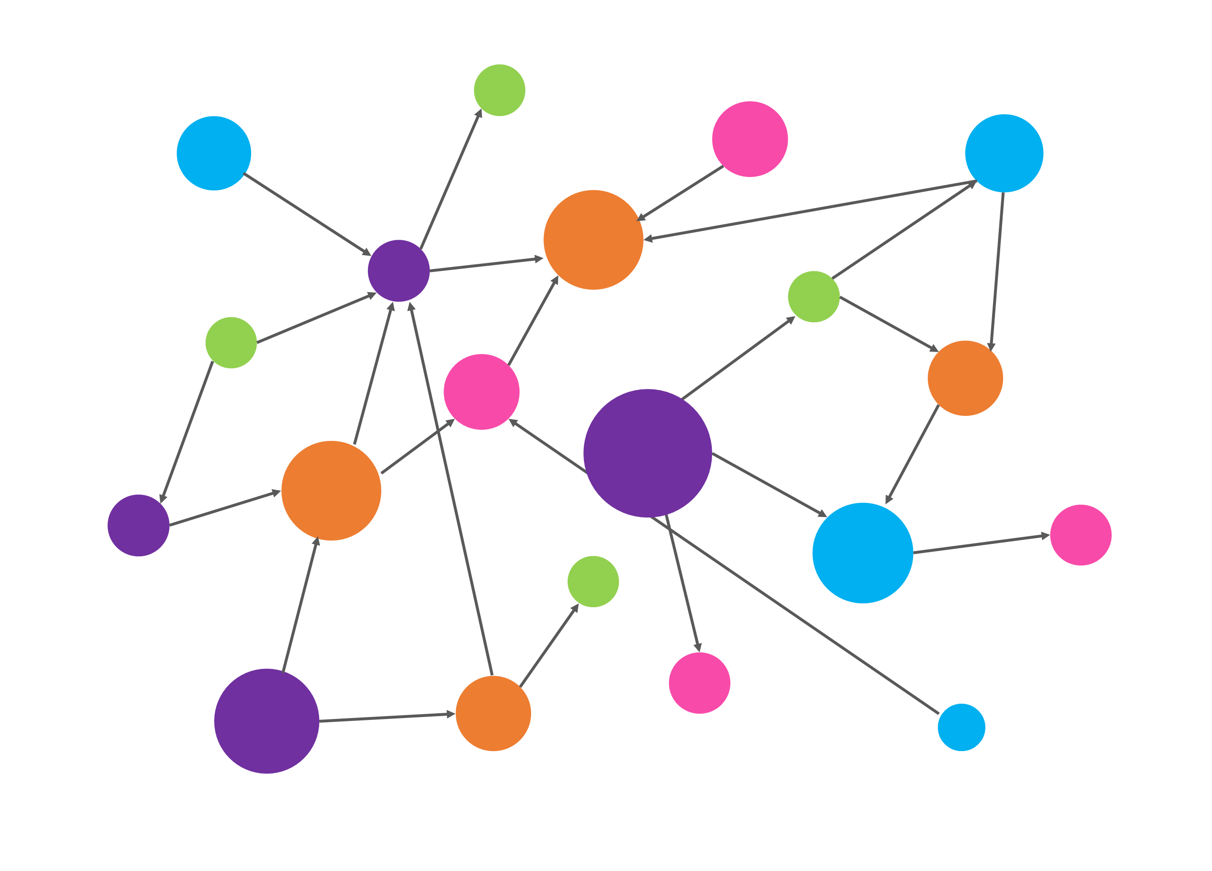
Graph structured data ​
Definition: Graph-structured data is a type of data that represents entities and their relationships in the form of nodes (vertices) and edges (links). This structure is particularly effective for modeling complex systems where interactions between entities are crucial.
Nodes: Nodes represent the entities or objects in the graph. In the context of traffic prediction, nodes could represent road segments, intersections, or other relevant points in the road network.
Each node can have associated features that provide additional information about the entity, such as traffic speed, road type, or historical travel times.
Edges: Edges represent the relationships or connections between nodes. In a road network, edges would represent the connections between road segments, such as intersections or highway ramps.
Features: Features are attributes associated with nodes and edges that provide essential information for the model.
Each node can have associated features that provide additional information about the entity, such as traffic speed, road type, or historical travel times.
Edge features could include connection types, turn speeds, and distances between segments. These features are crucial for the GNN to make accurate predictions.
ThePhoto by PhotoAuthor is licensed under CCYYSA.

Slide 10

Graphical representation of data
Nodes as Road Segments: In the graph representation, nodes are used to represent individual road segments. Each node captures specific attributes of the road segment, such as its length, traffic speed, and type of road (e.g., highway, arterial road).
Edges as Connections: Edges in the graph represent the connections between these road segments, such as intersections, ramps, or continuations of the same road. Edges contain information about the nature of the connection, including turn restrictions and traffic signal timings.
Node Features: Each node includes features that describe the road segment, such as real-time travel speeds, historical travel times, segment length, and priority (e.g., whether it is a main road or a minor street). These features are crucial for accurately modeling the current and future traffic conditions.
Edge Features: Edges have features that provide additional context about the connections between road segments. This includes information like the type of intersection, turn speeds, distances between connected segments, and traffic signal data. These features help in understanding how the movement between road segments affects overall travel time.
Global Graph Features: In addition to node and edge features, global features provide overall context about the traffic network. These may include weather conditions, time of day, and events that could impact traffic flow. Incorporating global features ensures that the model accounts for broader factors influencing travel times.

Slide 11
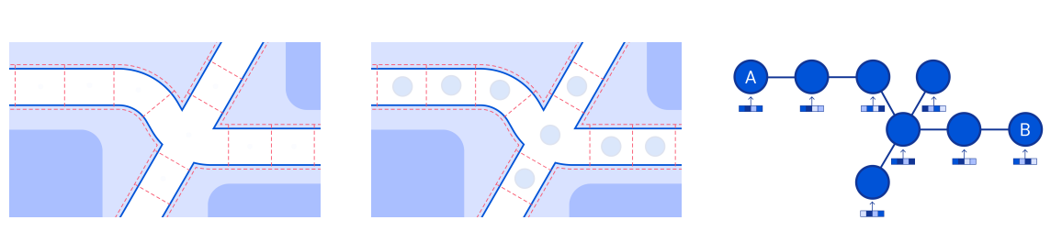
Segment (left side), Supersegment (right side)

Slide 12

Model architecture

Slide 13

Model Architecture
Graph Neural Network (GNN) Framework: The model utilizes the GNN framework, which is adept at handling graph-structured data like road networks. This framework includes message passing, where nodes aggregate information from their neighbors to update their representations iteratively.
Encode-Process-Decode Paradigm: The architecture follows an encode-process-decode paradigm. In the encoding phase, raw input features of nodes, edges, and the entire graph are transformed into latent representations. During the processing phase, multiple GN blocks iteratively refine these representations. Finally, in the decoding phase, the refined representations are transformed into travel time predictions.
Graph Network (GN) Blocks: The processor consists of multiple layers of GN blocks. Each block has update and aggregation functions for nodes, edges, and global features. These blocks perform message passing to update the node and edge representations by aggregating information from their neighbors.
Meta-Gradients and Semi-Supervised Training: The model incorporates Meta-Gradients, which dynamically adjust learning rates during training, enhancing stability and performance. Semi-supervised training techniques are used to leverage both labeled and unlabeled data, improving model robustness.
Prediction Horizons: The model predicts travel times for multiple future horizons, enabling it to account for how traffic conditions evolve over time. This multi-horizon prediction is crucial for providing accurate ETAs by considering both immediate and future traffic scenarios.

Slide 14

Encode-Process-Decode Paradigm
Encode :
Feature Transformation: The encoding phase transforms raw input features of nodes, edges, and the global graph into latent representations that are more suitable for processing by the GNN. This transformation captures the essential information in a high-dimensional space.
Node Features: Encodes features such as real-time and historical travel speeds, segment lengths, and road classifications into latent node representations. These features provide the foundational information for subsequent message passing.
Edge Features: Encodes features such as connection types, turn speeds, and traffic signal timings into latent edge representations. These features help capture the relationships and interactions between connected road segments.
Global Features: Encodes global context features such as weather conditions, time of day, and event data into a latent global representation. These features provide overall context that influences traffic conditions.
Learnable Embeddings: Uses learnable embedding vectors for nodes and edges to capture unique characteristics and patterns that are not explicitly represented by the raw features. These embeddings are refined during training to improve model performance.

Slide 15
Encode-Process-Decode Paradigm
Process:
Message Passing: During the processing phase, each node sends and receives messages to and from its neighboring nodes. These messages contain information that helps each node update its representation based on its neighbors' states.
Aggregation: Nodes aggregate the incoming messages from their neighbors using various aggregation functions (e.g., sum, mean, max). This aggregation helps nodes incorporate information from their local neighborhood.
Update Functions: Nodes, edges, and global features are updated based on the aggregated messages and their previous states. This iterative process refines the representations with each layer of GN blocks. The specific update functions include:
Edge Update (Φe): Computes a new representation for each edge using the current edge feature, and the features of the nodes it connects (source and target nodes), and the global feature.
Node Update (Φv): Computes a new representation for each node using the aggregated messages from neighboring edges, the node's current feature, and the global feature.
Global Update (Φu): Computes a new representation for the global feature using the aggregated node and edge representations and the current global feature.
Multiple Layers: The processor consists of multiple layers of GN blocks, allowing the model to capture long-range dependencies and complex interactions in the graph. Each layer performs a round of message passing and aggregation.
Stability Techniques: Techniques like Meta-Gradients are used during the processing phase to dynamically adjust learning rates, ensuring stable and robust training across different query batches.

Slide 16
Encode-Process-Decode Paradigm
Decode:
Transformation to Predictions: The decoding phase converts the refined latent representations of nodes, edges, and the global graph back into a format suitable for making predictions, specifically the estimated travel times.
Multi-Horizon Predictions: The decoder provides predictions for multiple future time horizons, enabling the model to account for how traffic conditions are expected to change over time.
Final Output Generation: The decoded outputs are the final predicted ETAs, which are used in real-time applications like Google Maps to provide accurate travel time estimates to users.
Refinement of Latent Representations: The decoding phase fine-tunes the latent representations obtained from the processing phase to ensure they accurately reflect the current and future states of the road network.
Efficiency and Scalability: The decoder is designed to efficiently handle large-scale graph data, ensuring that the model can provide real-time predictions even in extensive road networks.

Slide 17

Results
Improved Accuracy: The GNN model significantly reduces negative ETA outcomes compared to previous production baselines. Specifically, there is an over 40% reduction in negative ETA outcomes in cities like Sydney, demonstrating a substantial improvement in prediction accuracy.
Consistent Performance: Across various regions, the model consistently outperforms traditional methods. For example, in offline evaluations, the model shows RMSE improvements ranging from 0.12 to 0.77 over the closest baseline (DeepSets).
Quantitative Gains: Offline evaluations indicate substantial gains in RMSE metrics. The GNN model achieves an RMSE of 36.84 for Horizon 0 in Singapore, compared to 37.56 with DeepSets. Similar improvements are observed in New York (RMSE of 36.84 vs. 37.33), Los Angeles (RMSE of 40.32 vs. 40.71), and Tokyo (RMSE of 51.64 vs. 52.15).
Qualitative Advantages: In real-world scenarios, the model better predicts traffic congestion and variations in travel times. For instance, the GNN model accurately captures the increase in travel times during rush hours, outperforming real-time travel time baselines that fail to anticipate such congestion.
Real-World Impact: The deployment of the GNN model in Google Maps leads to tangible benefits for users. Online evaluations show that the model reduces RMSE of track travel times to 118.63 in New York, 138.10 in Los Angeles, 181.98 in Tokyo, and 108.78 in Singapore, compared to higher RMSE values with baseline methods. This enhances user experience and supports better decision-making for both personal and business travel.

Slide 18
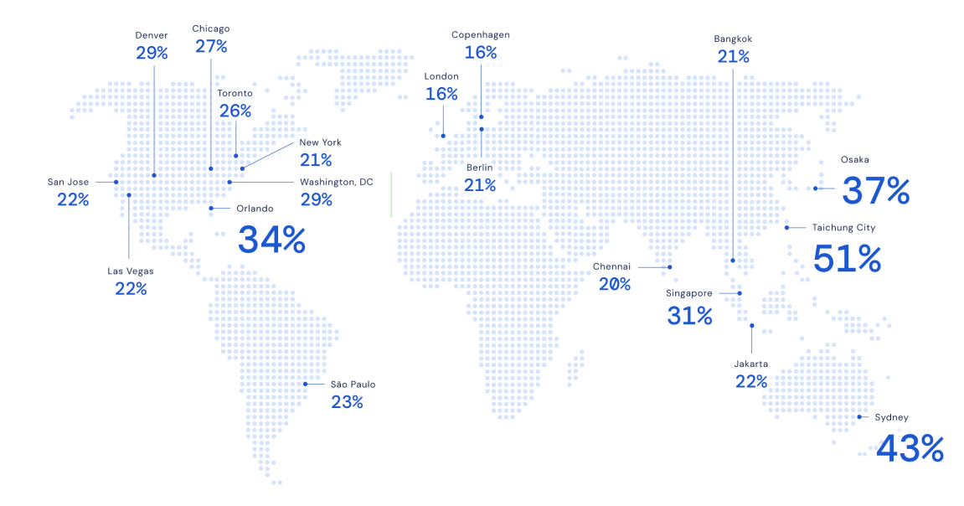

Slide 19


Critical Analysis
Key factors for model successful:
Using and integrating real-time traffic data, historical patterns, and external factors into the model.
Developing a Graph Neural Network (GNN) model specifically designed for accurate ETA prediction by leveraging the graph-structured nature of road networks.
Implementing techniques such as Meta-Gradients for the fine tuning of hyperparameters in the model to improve the model performance.
Using semi-supervised data for model training to ensure the model remains stable and performs reliably under various conditions and regions.
The model is designed with the strong motive to handle large-scale, real-time deployment in various real-time applications, by processing a vast number of queries efficiently.
The fact that a global giant like google is using this model, is a notable achievement for this model.

Slide 20
Critical Analysis
Advantages :
High Prediction Accuracy: The GNN model significantly improves ETA prediction accuracy, reducing negative ETA outcomes by over 40% in cities like Sydney. This demonstrates the model's effectiveness in capturing complex traffic dynamics.
Scalability: The model is designed to handle large-scale deployment, making it suitable for real-time applications like Google Maps. It efficiently processes a vast number of queries, ensuring timely and accurate ETA predictions for users worldwide.
Comprehensive Feature Integration: The model integrates a wide range of features, including real-time and historical travel speeds, road segment lengths, and external factors like weather conditions. This comprehensive approach ensures a holistic understanding of traffic conditions.
Adaptability to Different Regions: The model demonstrates consistent performance improvements across various regions, indicating its adaptability to different traffic environments and conditions. This generalizability is crucial for global applications like Google Maps.
Multiple Prediction Horizons: The model provides predictions for multiple future horizons, allowing it to account for how traffic conditions are expected to evolve over time. This feature enhances the accuracy and reliability of the ETA predictions.
Real-World Deployment: Successful deployment in Google Maps showcases the model's practical utility and real-world impact. The model's ability to enhance user experience and support better decision-making highlights its value in commercial applications.

Slide 21
Critical Analysis
Limitations:
Model Complexity: The GNN model is complex and requires significant computational resources for training. This complexity can be a barrier to deployment in environments with limited computational capabilities.
Data Storage and Inference Costs: Handling large-scale graph data can be resource-intensive, impacting storage and inference costs. This can limit the model's scalability and cost-efficiency, particularly for smaller organizations.
Dependence on High-Quality Data: The model's accuracy is heavily dependent on the quality and availability of real-time and historical traffic data. In regions with poor data coverage or low data quality, the model's performance may degrade.
Challenges in Real-Time Processing: While the model is designed for real-time applications, ensuring low-latency predictions in a high-traffic environment can be challenging. Any delays in data processing can affect the timeliness of ETA predictions.
Scalability Issues in Diverse Environments: Although the model performs well in various regions, scaling it to handle diverse traffic environments with unique characteristics may require additional adjustments and fine-tuning.
Maintenance and Updates: Maintaining and updating the model to reflect changes in road networks and traffic patterns can be resource-intensive. Continuous monitoring and adjustment are necessary to ensure sustained accuracy.

Slide 22

Future scope
Further Optimization of Model Architecture: Continuous improvements in the GNN architecture and training techniques can enhance performance and efficiency. Exploring advanced GNN variants and hybrid models that combine GNNs with other machine learning techniques may yield better results.
Integration of Additional Data Sources: Incorporating more diverse data sources such as real-time user feedback, detailed weather data, road incident reports, and social media feeds can provide richer context and improve the accuracy of ETA predictions.
Dynamic Aggregation Techniques: Researching and developing adaptive aggregation functions that can dynamically adjust based on traffic patterns and regional characteristics could enhance the model's ability to capture complex interactions in diverse environments.
Personalized ETA Predictions: Customizing ETA predictions based on individual user behavior, preferences, and historical travel patterns can improve user experience. Developing personalized models that account for user-specific factors can make predictions more relevant and accurate.
Real-Time Feedback and Continuous Learning: Enhancing the model with real-time feedback mechanisms and continuous learning capabilities can help it adapt quickly to changing traffic conditions. Implementing online learning algorithms that update the model in real-time based on new data can maintain and even improve prediction accuracy over time.

Slide 23
References
Gabriele Corso, Luca Cavalleri, Dominique Beaini, Pietro Liò, and Petar Veličković. 2020. Principal neighbourhood aggregation for graph nets. arXiv preprint arXiv:2004.05718 (2020).
arXiv:2004.05718 (2020). [6] Xiaomin Fang, Jizhou Huang, Fan Wang, Lingke Zeng, Haijin Liang, and Haifeng Wang. 2020. ConSTGAT: Contextual Spatial-Temporal Graph Attention Network for Travel Time Estimation at Baidu Maps. In Proceedings of the 26th ACM SIGKDD International Conference on Knowledge Discovery & Data Mining. 2697–2705
Kun Fu, Fanlin Meng, Jieping Ye, and Zheng Wang. 2020. CompactETA: A Fast Inference System for Travel Time Prediction. Association for Computing Machinery, New York, NY, USA, 3337–3345. https://doi.org/10.1145/3394486.3403386
Justin Gilmer, Samuel S Schoenholz, Patrick F Riley, Oriol Vinyals, and George E Dahl. 2017. Neural message passing for quantum chemistry. arXiv preprint arXiv:1704.01212 (2017)Will Hamilton, Zhitao Ying, and Jure Leskovec. 2017. Inductive representation learning on large graphs. In Advances in neural information processing systems. 1024–1034.
Jessica B Hamrick, Kelsey R Allen, Victor Bapst, Tina Zhu, Kevin R McKee, Joshua B Tenenbaum, and Peter W Battaglia. 2018. Relational inductive bias for physical construction in humans and machines. arXiv preprint arXiv:1806.01203 (2018)
Junheng Hao, Tong Zhao, Jin Li, Xin Luna Dong, Christos Faloutsos, Yizhou Sun, and Wei Wang. 2020. P-Companion: A Principled Framework for Diversified Complementary Product Recommendation. In Proceedings of the 29th ACM International Conference on Information & Knowledge Management. 2517–2524.
Conference on Knowledge Discovery & Data Mining. 842–852. [39] Chuanpan Zheng, Xiaoliang Fan, Cheng Wang, and Jianzhong Qi. 2020. GMAN: A Graph Multi-Attention Network for Traffic Prediction. In The Thirty-Fourth AAAI Conference on Artificial Intelligence, AAAI 2020, The Thirty-Second Innovative Applications of Artificial Intelligence Conference, IAAI 2020, The Tenth AAAI Symposium on Educational Advances in Artificial Intelligence, EAAI 2020, New York, NY, USA, February 7-12, 2020. AAAI Press, 1234–1241. https://aaai.org/ojs/ index.php/AAAI/article/view/547

Slide 24
Thank You

